Slide 1
Elementary Text Analysis & Topic Modeling
Kristina Lerman
University of Southern California
CS 599: Social Media Analysis
University of Southern California
Notes:
Access to data allows us to ask new questions, empirically measure effects

Slide 2
Why topic modeling
Volume of collections of text document is growing exponentially, necessitating methods for automatically organizing, understanding, searching and summarizing them
  Uncover hidden topical patterns in collections.
  Annotate documents according to topics.
  Using annotations to organize, summarize and search.

Slide 3
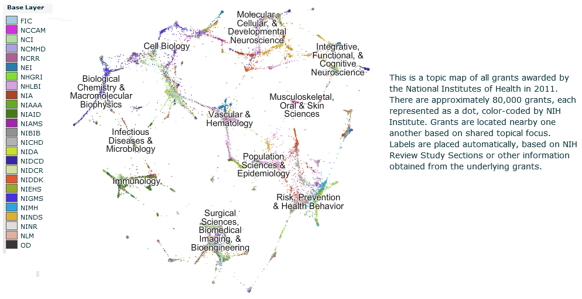
Topic Modeling
NIH Grants Topic Map 2011
NIH Map Viewer (https://app.nihmaps.org)
Notes:
Template I-Grey curve

Slide 4
Brief history of text analysis
1960s
  Electronic documents come online
  Vector space models (Salton)
  ‘bag of words’, tf-idf
1990s
  Mathematical analysis tools become widely available
  Latent semantic indexing (LSI)
  Singular value decomposition (SVD, PCA)
2000s
  Probabilistic topic modeling (LDA)
  Probabilistic matrix factorization (PMF)

Slide 5
Readings
Blei, D. M. (2012). Probabilistic topic models. Communications of the ACM, 55(4):77-84.
  Latent Dirichlet Allocation (LDA)
Yehuda Koren, Robert Bell and Chris Volinsky. Matrix Factorization Techniques For Recommender Systems. In Journal of Computer, 2009.

Slide 6
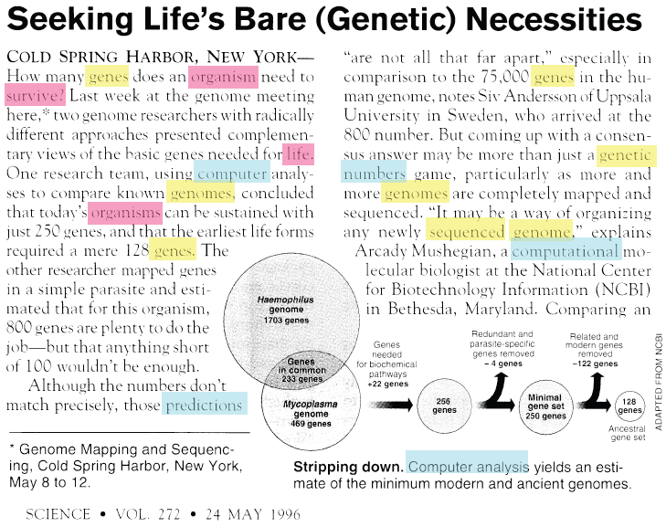
Vector space model
Term frequency
genes 5
organism 3
survive 1
life 1
computer 1
organisms 1
genomes 2
predictions 1
genetic 1
numbers 1
sequenced 1
genome 2
computational 1
…
Notes:
Tf idf
Stop words
Challenges - synonyms

Slide 7
Vector space models: reducing noise
stem words
remove stopwords
original
genes 5
organism 3
survive 1
life 1
computer 1
organisms 1
genomes 2
predictions 1
genetic 1
numbers 1
sequenced 1
genome 2
computational 1
gene 6
organism 4
survive 1
life 1
comput 2
predictions 1
numbers 1
sequenced 1
genome 4
and
or
but
also
to
too
as
can
I
you
he
she
…
Notes:
Tf idf
Stop words
Challenges - synonyms

Slide 8
Vector space model
Each document is a point in high-dimensional space
Document 2
gene 0
organism 6
survive 1
life 1
comput 2
predictions 1
numbers 1
sequenced 1
genome 4
…
organism
Document 1
gene 6
organism 4
survive 1
life 1
comput 2
predictions 1
numbers 1
sequenced 1
genome 4
…
gene
…

Slide 9
Vector space model
Each document is a point in high-dimensional space
Document 2
gene 0
organism 6
survive 1
life 1
comput 2
predictions 1
numbers 1
sequenced 1
genome 4
…
organism
Document 1
gene 6
organism 4
survive 1
life 1
comput 2
predictions 1
numbers 1
sequenced 1
genome 4
…
θ
gene
…
Compare two documents: similarity ~ cos(θ)

Slide 10
Improving the vector space model
Use tf-idf, instead of term frequency (tf), in the document vector
  Term frequency * inverse document frequency
  E.g.,
    ‘computer’ occurs 3 times in a document, but it is present in 80% of documents → tf-idf score ‘computer’ is 3*1/.8=3.75
    ‘gene’ occurs 2 times in a document, but it is present in 20% of documents → tf-idf score of ‘gene’ is 2*1/.2=10

Slide 11
Some problems with vector space model
Synonymy
  Unique term corresponds to a dimension in term space
  Synonyms (‘kid’ and ‘child’) are different dimensions
Polysemy
  Different meanings of the same term improperly confused
  E.g., document about river ‘banks’ will be improperly judged to be similar to a document about financial ‘banks’

Slide 12
Latent Semantic Indexing
Identifies subspace of tf-idf that captures most of the variance in a corpus
  Need a smaller subspace to represent document corpus
  This subspace captures topics that exist in a corpus
    Topic = set of related words
Handles polysemy and synonymy
  Synonyms will belong to the same topic since they may co-occur with the same related words

Slide 13
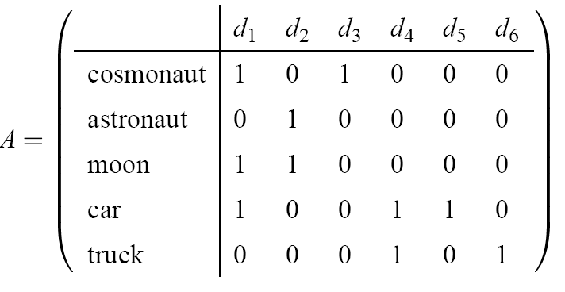
LSI, the Method
Document-term matrix A
Decompose A by Singular Value Decomposition (SVD)
  Linear algebra
Approximate A using truncated SVD
  Captures the most important relationships in A
  Ignores other relationships
  Rebuild the matrix A using just the important relationships

Slide 14
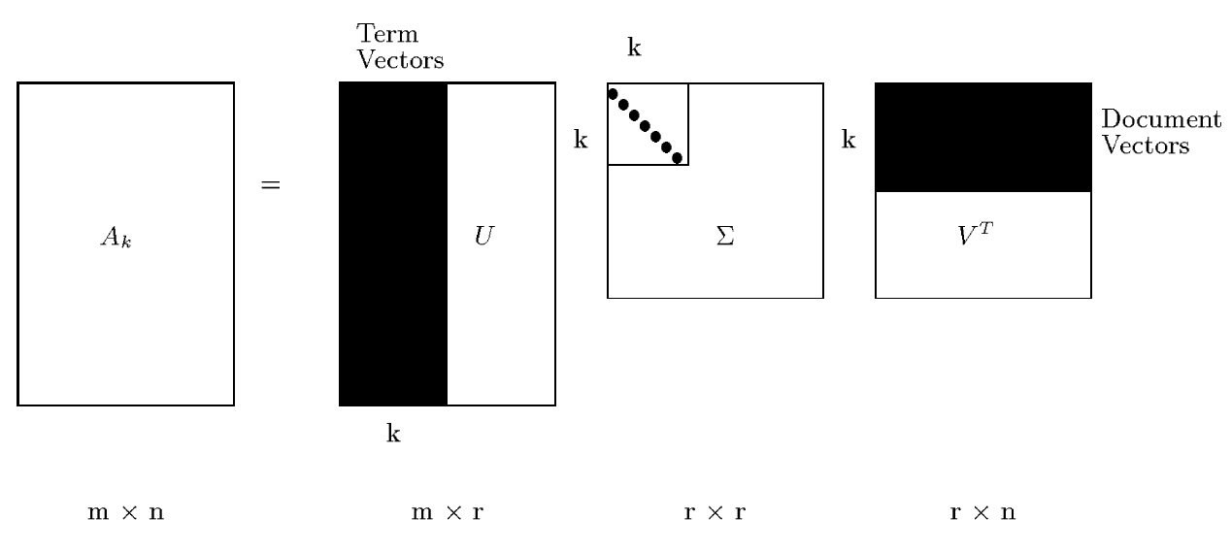
LSI, the Method (cont.)
Each row and column of A gets mapped into the k-dimensional LSI space, by the SVD.

Slide 15
Singular value decomposition
SVD- Singular value decomposition
  http://en.wikipedia.org/wiki/Singular_value_decomposition
Notes:
Unitary matrix
Hermit matrix

Slide 16
Lower rank decomposition
Usually, rank of the matrix A is small: r<<min(m,n).
  Only a few of the largest eigenvectors (those associated with the largest eigenvalues λ) matter
  These r eigenvectors define a lower dimensional subspace that captures most important characteristics of the document corpus
  All operations (document comparison, similar) can be done in this reduced-dimension subspace

Slide 17
Probabilistic Modeling
Generative probabilistic modeling
  Treats data as observations
  Contains hidden variables
  Hidden variables reflect the themes that pervade a corpus of documents
Infer hidden thematic structure
  Analyze words in the documents
  Discover topics in the corpus
    A topic is a distribution over words
  Large reduction in description length
    Few topics are needed to represent themes in a document corpus – about 100
Notes:
Template I-Grey curve

Slide 18
LDA – Latent Dirichlet Allocation (Blei 2003)
Intuition: Documents have multiple topics
Notes:
Simple Intuition: Documents exhibit multiple topics
Template I-Grey curve

Slide 19
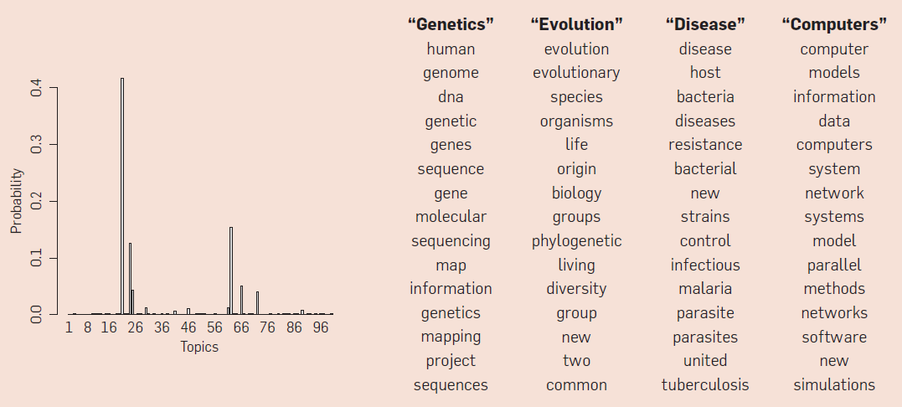
Topics
A topic is a distribution over words
A document is a distribution over topics
A word in a document is drawn from one of those topics
Document
Topics

Slide 20
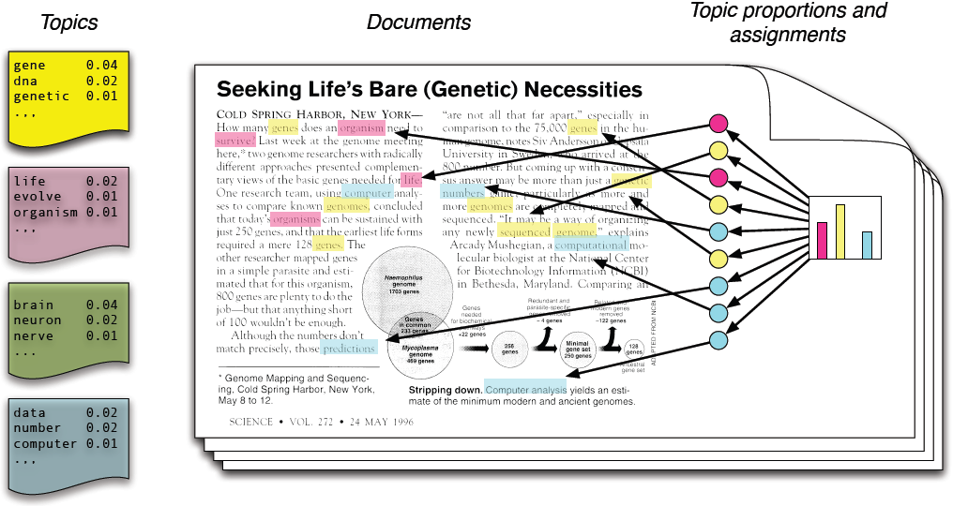
Generative Model of LDA
Each topic is a distribution over words
Each document is a mixture of corpus-wide topics
Each word is drawn from one of those topics
Notes:
Every topic is a distribution over a fixed vocabulary.
Every document is a random mixture of corpus-wide topics.
Choose a distribution over topics.
For each word, draw a colored coin from this distribution.
Look up the distribution of terms associated with that coin.
Draw that word from that distribution.
This process is repeated for every document.
Template I-Grey curve

Slide 21
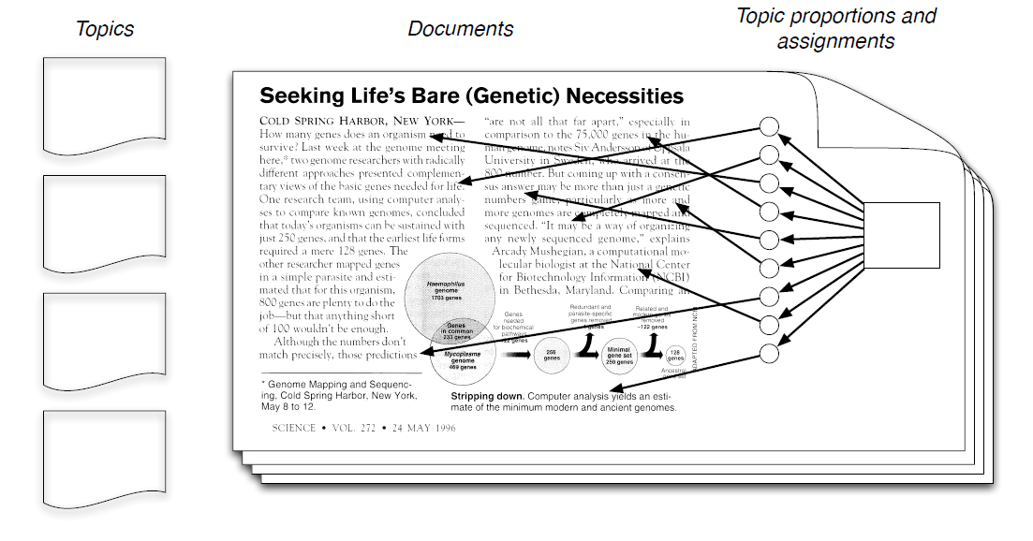
LDA inference
We observe only documents
The rest of the structure are hidden variables

Slide 22
LDA inference
Our goal is to infer hidden variables
Compute their distribution conditioned on the documents
  p(topic, proportions, assignments | documents)

Slide 23
Posterior Distribution
Only documents are observable.
Infer underlying topic structure.
  Topics that generated the documents.
  For each document, distribution of topics.
  For each word, which topic generated the word.
Algorithmic challenge: Finding the conditional distribution of all the latent variables, given the observation.
Notes:
Template I-Grey curve

Slide 24
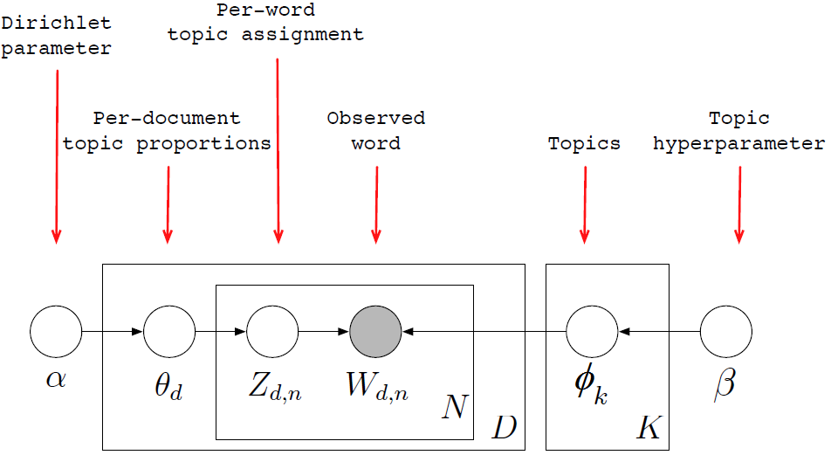
LDA as Graphical Model
Encodes assumptions
Defines a factorization of the joint distribution
Notes:
Template I-Grey curve

Slide 25
LDA as Graphical Model
Nodes are random variables; edges indicate dependence
Shaded nodes are observed; unshaded nodes are hidden
Plates indicate replicated variables
Notes:
Template I-Grey curve

Slide 26
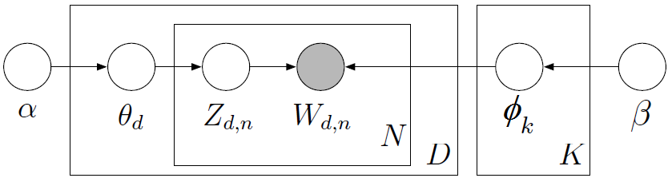
Posterior Distribution
  This joint defines a posterior p(θ, z, β|W):
From a collection of documents W, infer
  Per-word topic assignment z_{d,n}
  Per-document topic proportions θ_{d}
  Per-corpus topic distribution φ_{k}
Notes:
Template I-Grey curve

Slide 27
Posterior Distribution
Evaluate p(z|W): posterior distribution over the assignment of words to topic.
θ and φ can be estimated.
Computing p(z|W) involves evaluating a probability distribution over a large discrete space.
Notes:
Template I-Grey curve

Slide 28
Approximate posterior inference algorithms
Mean field variational methods
Expectation propagation
Gibbs sampling
Distributed sampling
…
Efficient packages for solving this problem

Slide 29
Example
Data: collection of Science articles from 1990-2000
  17K documents
  11M words
  20K unique words (stop words and rare words removed)
Model: 100-topic LDA

Slide 30
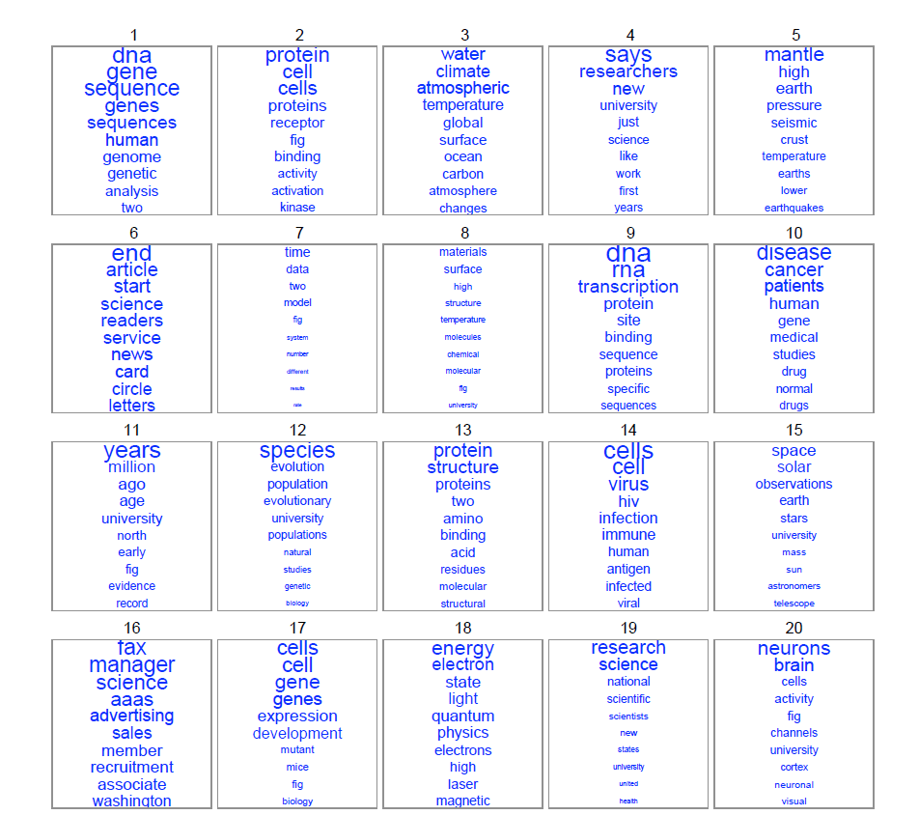

Slide 31
Extensions to LDA
Extension to LDA relax assumptions made by the model
  “bag of words” assumption: order of words does not matter
    in reality, the order of words in the document is not arbitrary
  Order of documents does not matter
    But in historical document collection, new topics arise
  Number of topics is known and fixed
    Hierarchical Baysian models infer the number of topics

Slide 32
How useful are learned topic models
Model evaluation
  How well do learned topics describe unseen (test) documents
  How well it can be used for personalization
Model checking
  Given a new corpus of documents, what model should be used? How many topics?
Visualization and user interfaces
Topic models for exploratory data analysis

Slide 33
Recommender systems
Personalization tools allow filtering large collections of movies, music, tv shows, … to recommend only relevant items to people
  Build a taste profile for a user
  Build topic profile for an item
  Recommend items that fit user’s taste profile
Probabilistic modeling techniques
  Model people instead of documents to learn their profiles from observed actions
Commercially successful (Netflix competition)

Slide 34

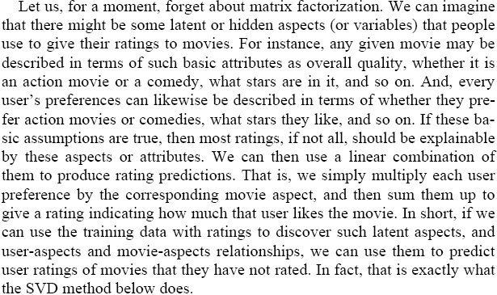
The intuition

Slide 35




















User-item rating prediction
Items
…
Ratings
4.0
5.0
1.0
2.0
Users
…

Slide 36
Collaborative filtering
Collaborative filtering analyzes users’ past behavior and relationships between users and items to identify new user-item associations
  Recommend new items that “similar” users liked
  But, “cold start” problem makes it hard to make recommendations to new users
Approaches
  Neighborhood methods
  Latent factor models

Slide 37
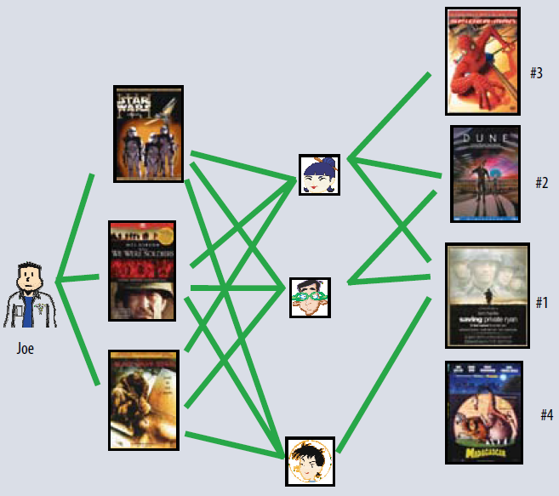
Neighborhood methods
Identify similar users who like the same movies.
User their ratings of other movies to recommend new movies to user

Slide 38
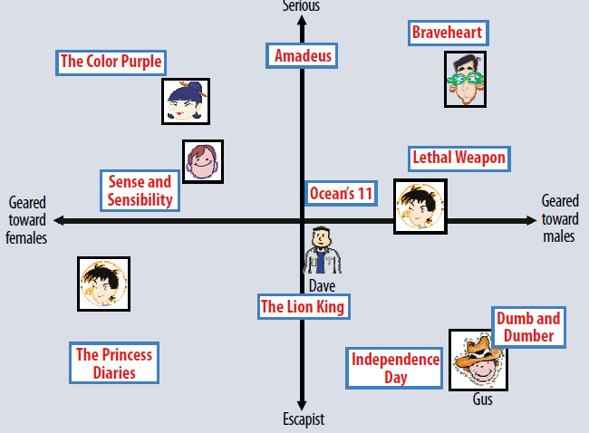
Latent factor models
Characterize users and items by 20 to 100 factors, inferred from the ratings patterns

Slide 39

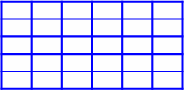




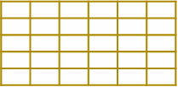
Probabilistic Matrix Factorization (PMF)
Item
Item: distribution over topics
Topic
V
Item
TV series, Classic, Action…
User
R
User
Drama, Family, …
Topic
U
R=U^{T}V
Marvel’s hero, Classic, Action...
User: distribution over topics

Slide 40
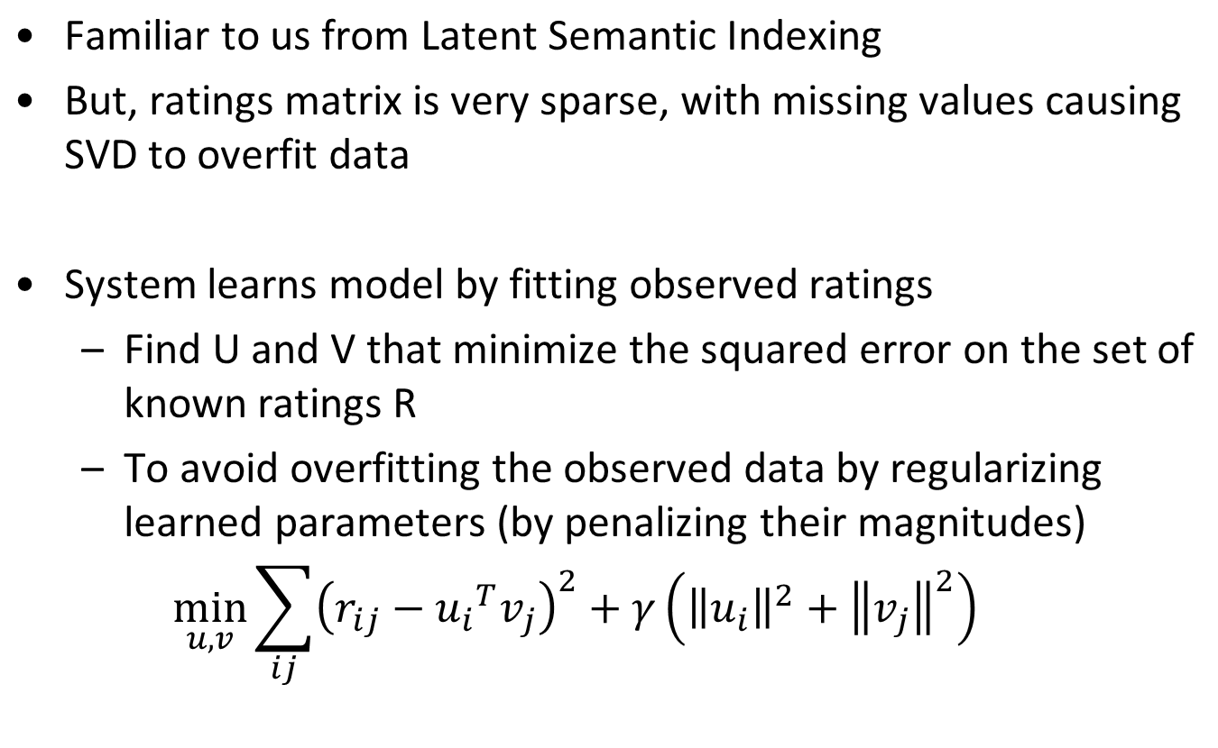
Singular Value Decomposition

Slide 41





Probabilistic formulation
“PMF is a probabilistic linear model with Gaussian observation noise that handles very large and possibly sparse data.”
Item
Topic
V
Item’s topics
Item
U^{T}V
User’s topics
User
R
User
PMF
[Salakhutdinov & Mnih 08]
Topic
U

Slide 42
Inference
Minimize regularized error by
Stochastic gradient descent (http://sigter.org/~simon/journal/20051211.html)
  Compute prediction error for a set of parameters
  Find the gradient (slope) of parameters
  Modify parameters by a magnitude proportional to negative of the gradient
Alternating least squares
  When one parameter is unknown, becomes an easy quadratic function that can be solved using least squares
  Fix U, find V using least squares. Fix V, find U using least squares

Slide 43
Application: Netflix challenge
2006 contest to improve movie recommendations
Data
  500K Netflix users (anonymized)
  17K movies
  100M ratings on scale of 1-5 stars
Evaluation
  Test set of 3M ratings (ground truth labels withheld)
  Root-mean-square error (RMSE) on the test set
Prize
  $1M for beating Netflix algorithm by 10% on RMSE
  If no winner, $50K prize to leading team

Slide 44
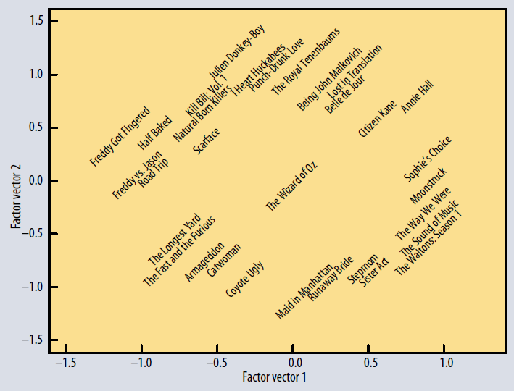
Factorization models in the Netflix competition
Factorization models gave leading teams an advantage
  Discover most descriptive “dimensions” for predicting movie preferences …

Slide 45
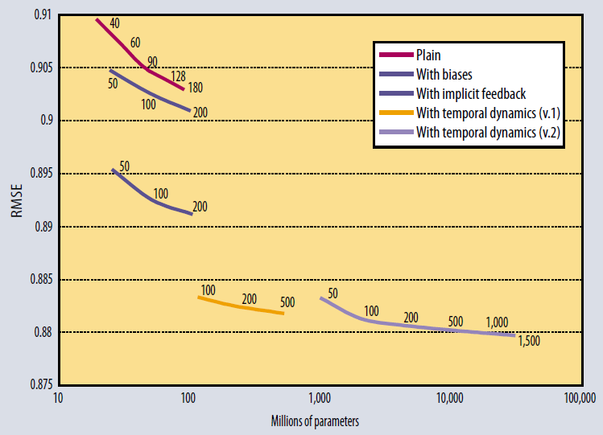
Performance of factorization models
Model performance depends on complexity
Netflix algorithm: RMSE=0.9514
Grand prize target: RMSE=0.8563

Slide 46
Summary
Hidden factors create relationships among observed data
  Document topics give rise to correlations among words
  User’s tastes give rise to correlations among her movie ratings
Methods for inferring hidden (latent) factors from observations
  Latent semantic indexing (SVD)
  Topic models (LDA, etc.)
  Matrix factorization (SVD, PMF, etc.)
Trade off between model complexity, performance and computational efficience

Slide 47
Tools
Topic modeling
  Blei's LDA w/ "variational method" (http://cran.r-project.org/web/packages/lda/) or
  "Gibbs sampling method" (https://code.google.com/p/plda/ and http://gibbslda.sourceforge.net/)
PMF
  Matlab implementation (http://www.cs.toronto.edu/~rsalakhu/BPMF.html)
  Blei's CTR code (http://www.cs.cmu.edu/~chongw/citeulike/).

